Slide 1




PREDICTING
MEDICAL COST
BY CHOY JEE HUNG CALEB P2341475

Slide 2


TABLE OF CONTENT
1
2
3
Data Exploration
Data Preprocessing
Model building
4
5
6
Model Evaluation
Model Improvements
Results & Conclusion

Slide 3
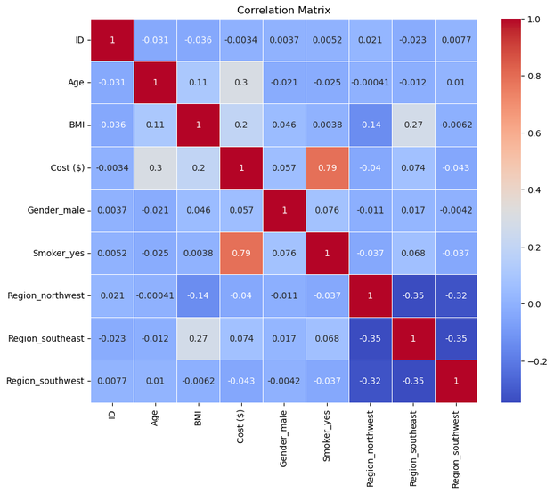
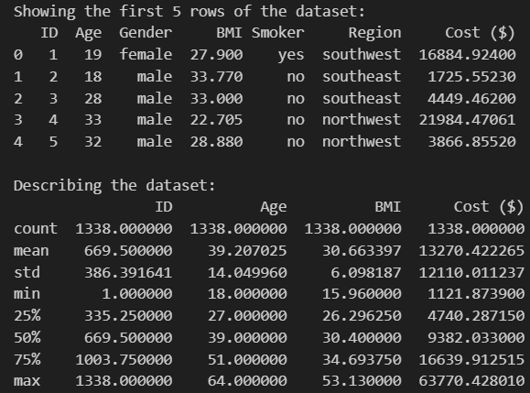
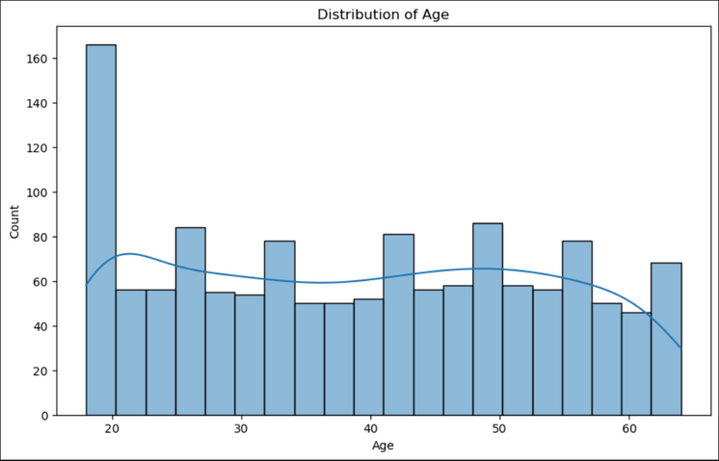
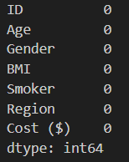
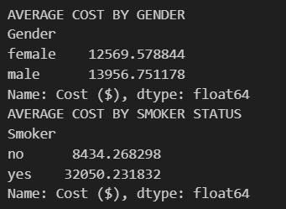
Data Exploration
To understand the structure and characteristics of the dataset.
Examine basic statistics (mean, median, standard deviation).
Visualize distributions of features to identify patterns.
Check for missing values and outliers.
Explore relationships between variables through correlation analysis.

Slide 4
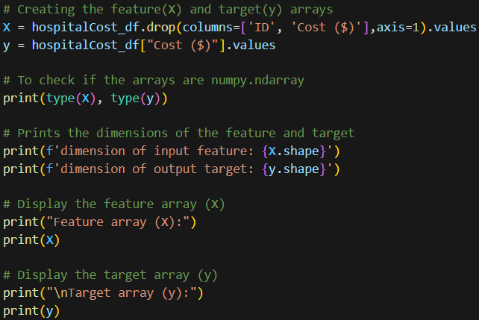
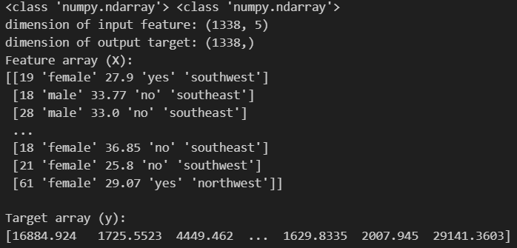
Data Preprocessing-Target/Features
The output variable/target is the variable you are trying to predict. In this case, it is the hospital cost ($).
Our prediction task is the prediction of hospital cost ($) based on various patient information, such as ID, Age, Gender, BMI, etc.
Knowing this, we can select our target (Quality) & features (The rest of the columns).
We also would drop irrelevant features such as ID as it provides no correlation to the target.

Slide 5
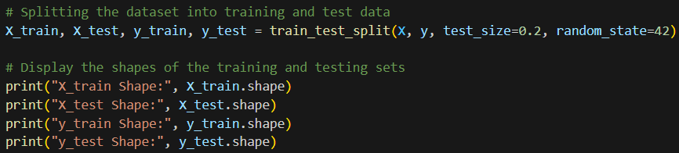
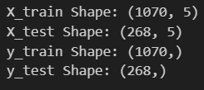
Data Preprocessing-Splitting
Splitting the dataset up into 2 different sets; Training set and Testing set for reasons such as:
Preventing Overfitting
Estimating Model Performance
Hyperparameter Tuning

Slide 6
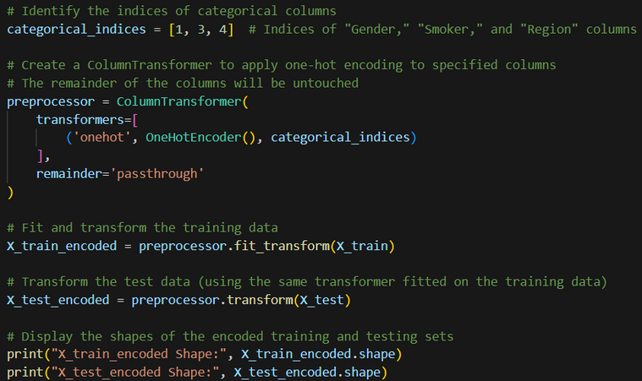
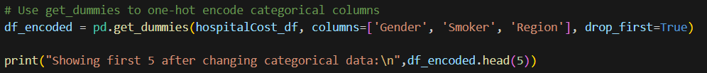
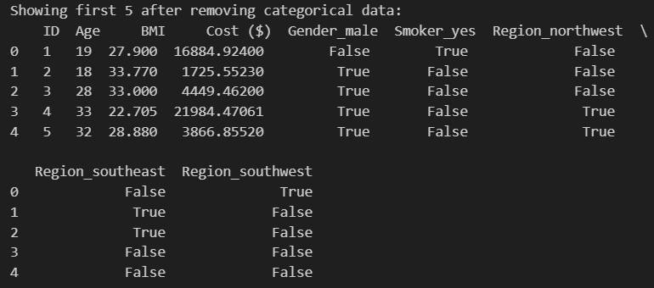
Data Preprocessing-Cleaning
Handle categorical data by using OneHotEncoder or get_dummies
Detect and address outliers, considering whether they were genuine data points or errors.

Slide 7
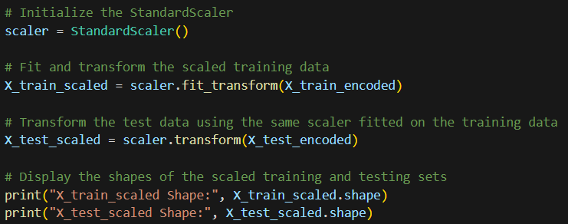
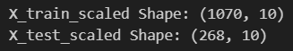
Data Preprocessing-Normalization/Standarize
Standardized or normalized numerical features to ensure consistent scales. Some learning models such as KNN, benefit from better accuracy by doing this step since they are sensitive to outliers and large ranges of data.

Slide 8
Classification learning models used
01
02
03
04
05
Decision Tree
Support Vector Machines
Random Forest Tree
Linear Regression
K-Nearest Neighbours

Slide 9
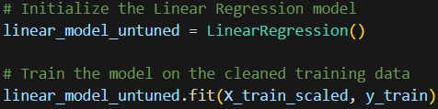
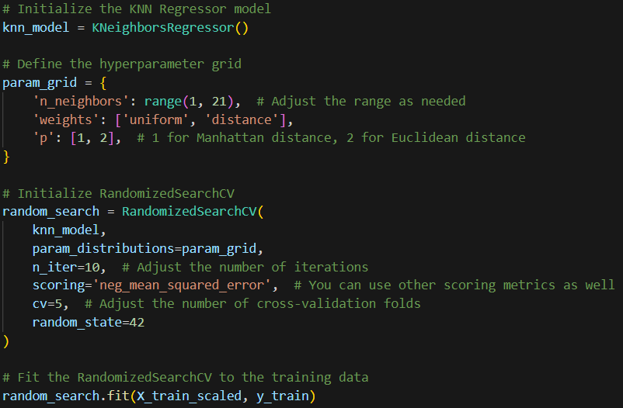
Model Building
Train models on the training data by fitting the data to the model.
For example, a fit on the Linear Regression Model,
Or, with some hyperparameters such as the one done in this K-Nearest Neighbour Model,

Slide 10
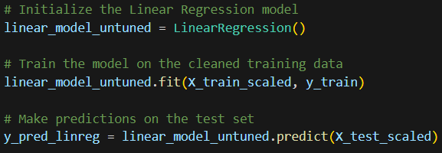
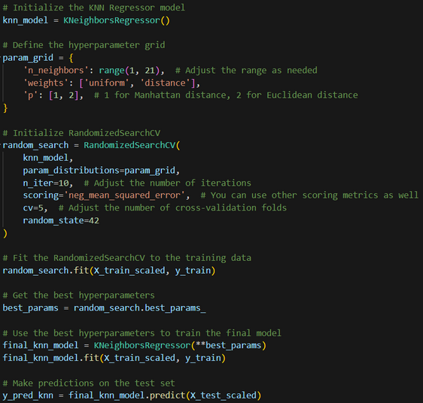
Model Evaluation-Predict
Evaluate models on the testing data by predicting the data on the model.
For example, on the Logisitic Regression Model,
Or, after adding hyperparameters such as the one done in this K-Nearest Neighbour Model,

Slide 11
Model Evaluation-Scores & Reports
Evaluate models by utilizing common evaluation metrics such as Mean Squared Error, Root Mean Square Error, Mean Absolute Error, Mean Absolute Percentage Error, R-2 score.
Mean Squared Error | The average of the squared differences between the predicted values and the actual values. Lower values of MSE indicate better performance.
Root Mean Square Error | The square root of the MSE. RMSE is also expressed in the same units as the predicted values.
Mean Absolute Error | The average of the absolute differences between the predicted values and the actual values. Lower values of MAE indicate better performance.
Mean Absolute Percentage Error | The average of the absolute percentage errors. MAPE is a percentage metric and is useful when the range of the predicted values is wide.
R-2 Score | A measure of how well the model explains the variation in the data. R-squared values range from 0 to 1, with 1 indicating a perfect fit.

Slide 12
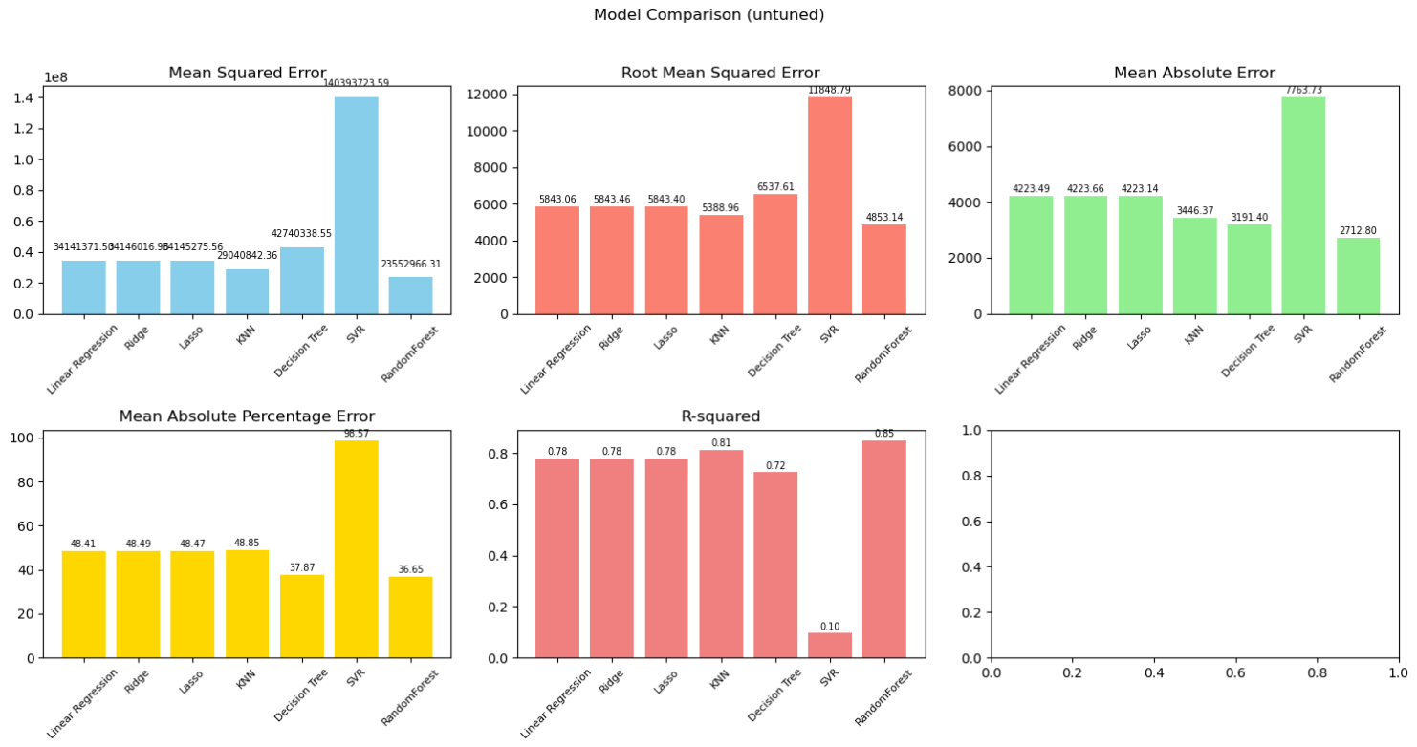
Model Evaluation-Visualization
Evaluate models easily and more user friendly by utilizing visualization methods to display for ease of comparison.

Slide 13
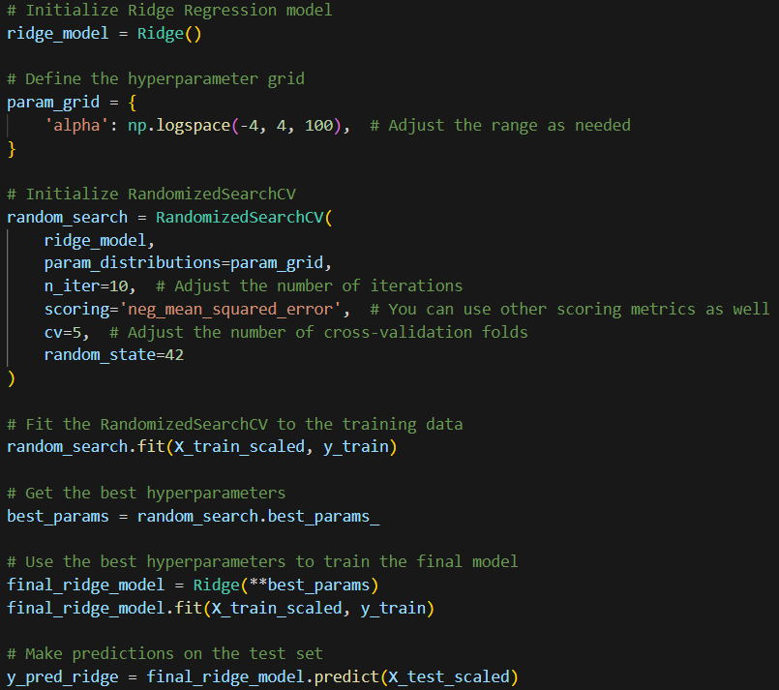
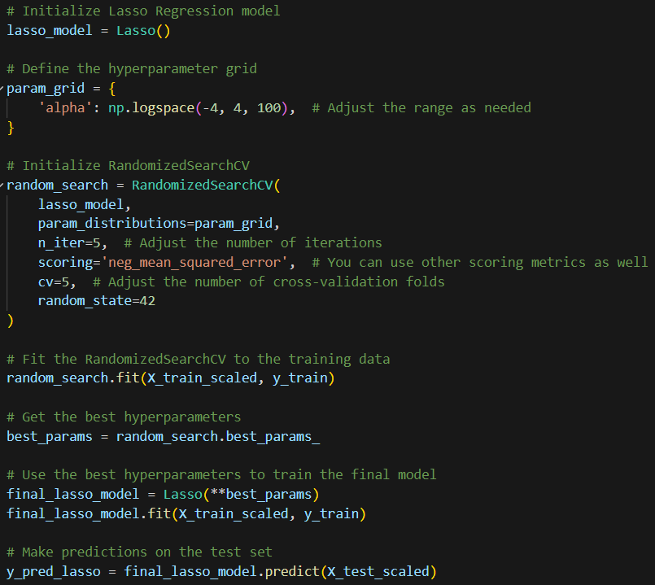
Model Improvements-HyperParameter
After viewing the evaluation for each model respectively, I am able to decide on how we want to change our hyperparameters for each of our models. Some examples are from linear regression:
Ridge:
Lasso:
Ridge is a linear regression technique that addresses the shortcomings of ordinary least squares (OLS) regression penalizes large coefficients, which helps to prevent overfitting and improve the generalizability of the model
Lasso is a linear regression technique that utilizes an L1 regularization penalty to address the drawbacks of ordinary least squares (OLS) regression. which penalizes large coefficients, encouraging the model to select a smaller subset of relevant features and shrinking less significant ones towards zero

Slide 14
Model Improvements-Evaluation pt2
Do a randomized search over parameters, where each setting is sampled from a distribution over possible parameter values in order to tune the hyperparameter and then use the cross validation to check as seen using RandomizedSearchCV.
Ridge:
Lasso:

Slide 15

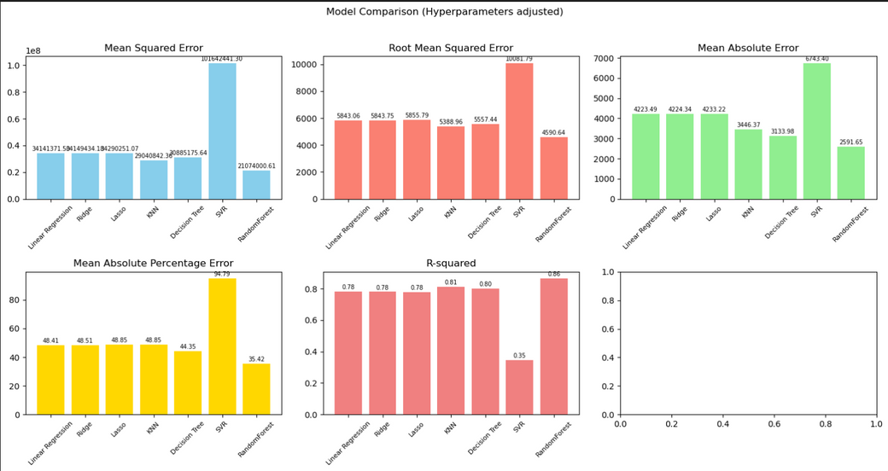
Model Evaluation-Visualization pt2
There is changes in the evaluation after hyperparameter tuning showing that the performance of the models can either increase or decrease.
Before changing hyperparameters:
After changing hyperparameters:

Slide 16
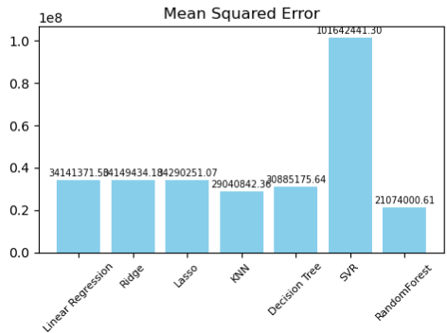
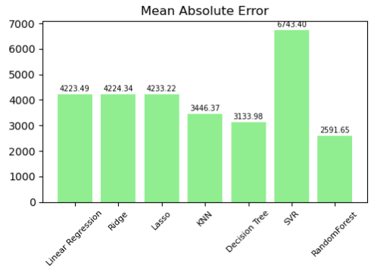
Results
Mean Squared Error | The average of the squared differences between the predicted values and the actual values. Lower values of MSE indicate better performance.
Mean Absolute Error | The average of the absolute differences between the predicted values and the actual values. Lower values of MAE indicate better performance.
The model with the lowest Mean Squared Error is the RandomForest model followed by KNN model.
The model with the lowest Mean Absolute Error is the RandomForest model followed by Decision tree model.

Slide 17
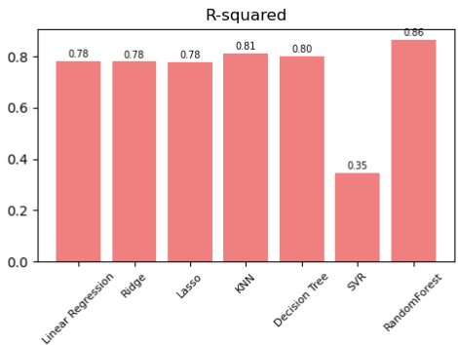
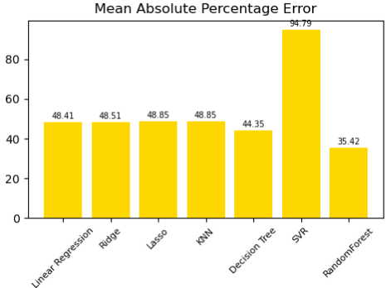
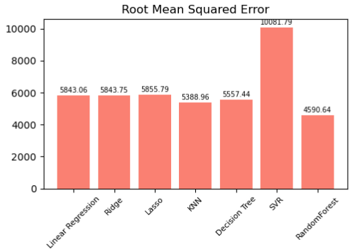
R-2 Score | A measure of how well the model explains the variation in the data. R-squared values range from 0 to 1, with 1 indicating a perfect fit.
Mean Absolute Percentage Error | The average of the absolute percentage errors. MAPE is a percentage metric and is useful when the range of the predicted values is wide.
The model with the largest R-squared value is the RandomForest model followed by KNN model.
The model with the lowest MAPE value is the RandomForest model followed by KNN model.
The model with the lowest RMSE value is RandomForest tree model followed by KNN model.
Root Mean Square Error | The square root of the MSE. RMSE is also expressed in the same units as the predicted values.

Slide 18

Best Model to use
The best model to use would be the RandomForestTree model.
With the lowest Mean Squared Error, Mean Absolute Error, Mean Absolute Percentage Error, Root Mean Squared Error, combined with the fact that it has the largest R-squared value, shows that it is the best model to use to predict the hospital cost through regression.
21074000.61
2591.65
Mean Squared Error
Mean Absolute Error
0.86
36.65%
4853.14
R-sqaured Score
Mean Absolute Percentage Error
Root Mean Sqaure Error

Slide 19

Conclusion
Regression in machine learning is a powerful tool to predict outcomes based on data. Be it simple linear regression between two variables or more complex models like multiple linear or polynomial regression, the goal remains to uncover patterns and make accurate predictions.
The success of regression models relies on careful feature selection, consider potential biases, and continuously refine the model to ensure its effectiveness in real-world scenarios

Slide 20


THANK YOU!
THE END

